Slide 1
IBM University Engagement Project Submission
“Exploring the Power of Agentic AI with IBM Granite and IBM Bob”

Slide 2
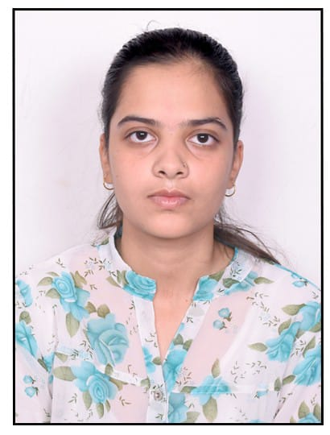
Project Tile – AI Research Agent
Domain of Project –Education / Research / Artificial Intelligence
Student Name | Recent Passport Photo | Email ID | Mobile number [WhatsApp]
Bhoomika Patle |  | bhoomikapatle412@gmail.com | 7805878908

Slide 3
Problem Statement -
Problem Statement : Research Agent
The Challenge
Researchers and students deal with large amounts of academic papers, journals, technical articles, and research data spread across different platforms. Finding relevant papers, understanding them, identifying research gaps, and keeping track of emerging topics is time-consuming.
The Objective
Build an AI-powered Research Agent that provides intelligent research assistance and insights for students and researchers. The solution should:
Academic Paper Retrieval – Find relevant research papers based on user queries.
Paper Analysis & Summarization – Extract key information and generate concise summaries.
RAG-Based Q&A – Answer questions using information from uploaded research papers.
Multi-Agent System –
Search Agent – Retrieves relevant papers.
Analysis Agent – Analyzes and summarizes papers.
Comparison Agent – Compares multiple papers.
Research Gap Agent – Identifies research gaps and limitations.
Research Trend Analysis – Identify emerging topics and trends.
Visualization Dashboard – Present research insights and trends in an easy-to-understand format.

Slide 4
Proposed Solution -
Proposed Solution: AI Research Agent
The proposed solution is an Agentic AI-powered research assistant that combines RAG, specialized AI agents, academic APIs, and IBM Granite models to simplify the research process.
The system allows users to:
Search for relevant academic papers.
Upload and analyze research PDFs.
Ask questions about research papers using RAG.
Generate structured paper summaries.
Compare multiple research papers.
Identify research gaps and limitations.
Analyze emerging research trends.
Visualize research insights through an interactive dashboard.
Goal: Transform scattered academic information into structured, actionable research insights.

Slide 5
How the Solution Works
Working of AI Research Agent
Step 1 — User Input User enters a research topic, question, or uploads a PDF.
↓
Step 2 — Research Retrieval The system retrieves relevant papers from academic sources or extracts information from uploaded documents.
↓
Step 3 — RAG Pipeline Documents are processed, chunked, embedded, and stored in a vector database.
↓
Step 4 — Agentic Processing Specialized agents analyze, summarize, compare, and reason over the retrieved information.
↓
Step 5 — IBM Granite Granite models generate contextual and structured responses.
↓
Step 6 — Research Insights The user receives summaries, answers, comparisons, research gaps, and trend visualizations.

Slide 6
Technology Used
Technology Stack
IBM Technologies
IBM Bob – AI-assisted application development and project implementation.
IBM Granite Models – Natural language understanding, reasoning, summarization, and research analysis.
IBM watsonx.ai – AI model integration and deployment.
IBM Langflow / Agentic workflow – Designing and connecting AI components.
Other Technologies
Python – Backend and AI processing.
RAG – Retrieval-Augmented Generation for grounded research answers.
Vector Database – FAISS / ChromaDB for semantic document retrieval.
Academic APIs – arXiv / Semantic Scholar for research-paper retrieval.
Frontend / Dashboard – Interactive interface for research exploration.

Slide 7
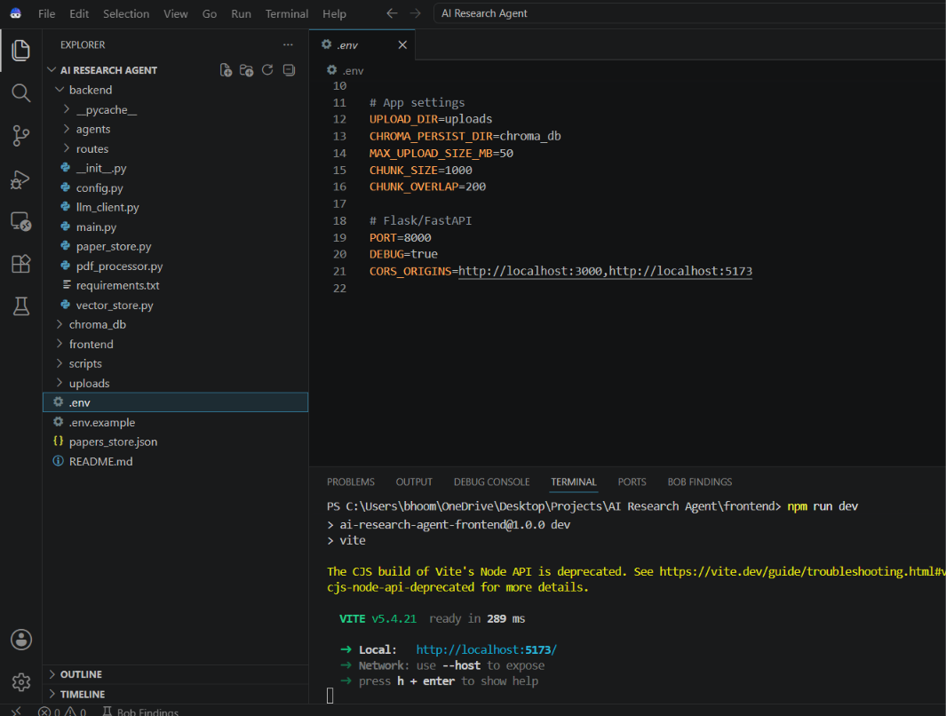
Required Files created using IBM bob -
backend/main.py
2. backend/config.py
3. backend/llm_client.py
4. backend/vector_store.py
5. backend/pdf_processor.py
6. backend/agents/search_agent.py
7. backend/agents/rag_agent.py
8. frontend/src/App.jsx
9. frontend/src/api.js
10. .env.example

Slide 8
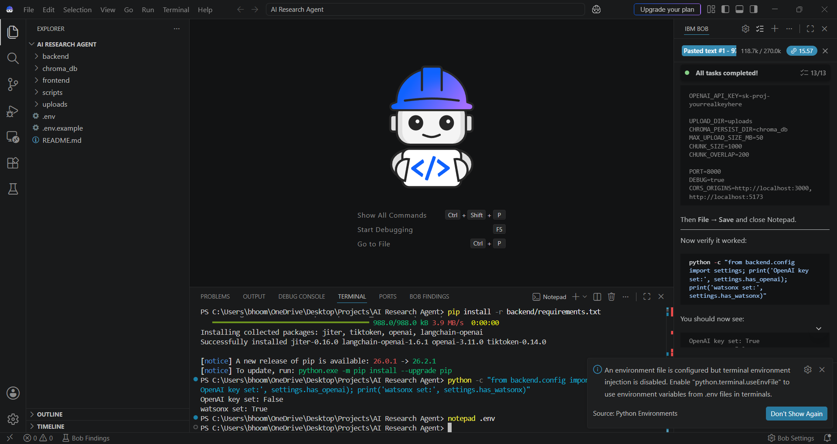
IBM Bob Screenshots:

Slide 9
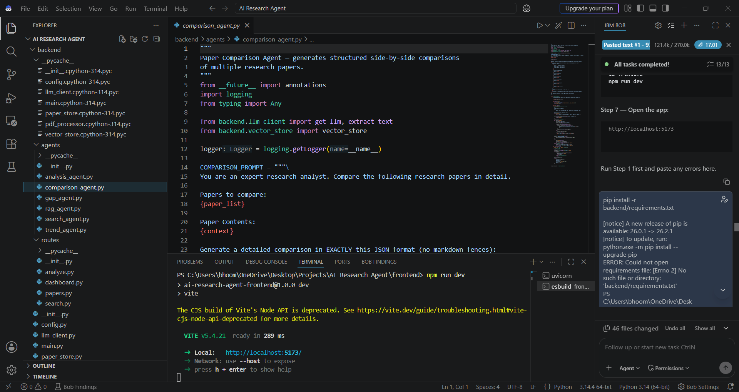

Slide 10

Role of Agentic AI in the solution
Role of Agentic AI in the Solution
Agentic AI enables the Research Agent to perform multiple research tasks autonomously instead of functioning as a simple chatbot.
Paper Search Agent finds relevant academic literature.
Paper Analysis Agent extracts and summarizes important information.
RAG Research Agent answers questions using retrieved documents.
Comparison Agent analyzes similarities and differences between papers.
Research Gap Agent identifies limitations and unexplored areas.
Trend Analysis Agent detects emerging research topics.
The agents work together to transform raw academic information into meaningful and actionable research insights.
.

Slide 11
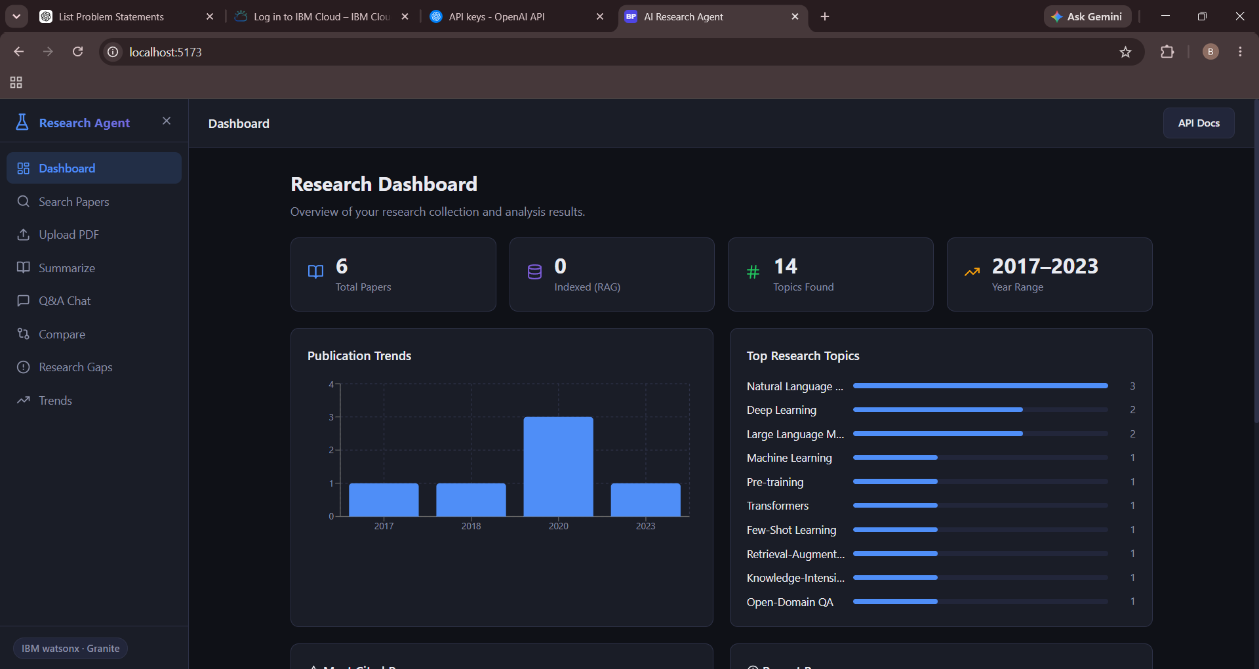
Project Output Screenshot
Please put IBM Bob output screenshots with 2-3 prompts.
You can take 2-3 more slides for each screenshot
·
·
·

Slide 12
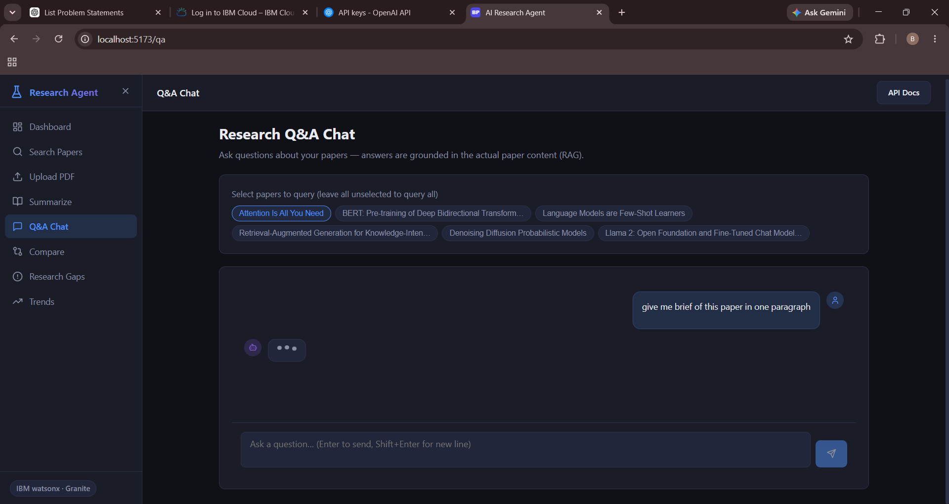
Project Output Screenshot
Please put IBM Bob output screenshots with 2-3 prompts.
You can take 2-3 more slides for each screenshot
·
·
·

Slide 13
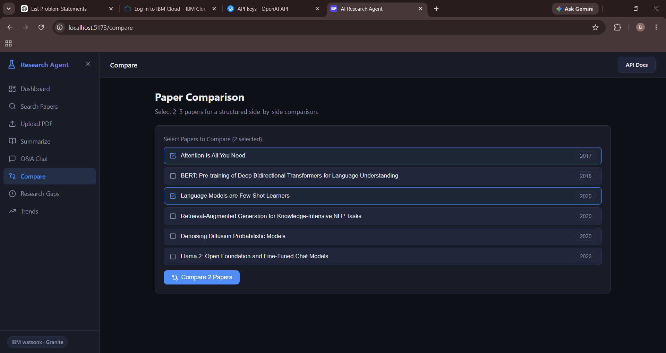
Project Output Screenshot
Please put IBM Bob output screenshots with 2-3 prompts.
You can take 2-3 more slides for each screenshot
·
·
·

Slide 14
Novelty and Uniqueness
Multi-Agent Research Workflow Multiple specialized agents collaborate instead of relying on a single chatbot.
2. RAG-Based Research Analysis The system retrieves relevant research content before generating answers.
3. Automated Research Gap Detection Identifies limitations and unexplored areas across multiple papers.
4. Intelligent Paper Comparison Compares methodology, datasets, results, strengths, and limitations.
5. Research Trend Analysis Helps identify emerging topics and changing research directions.
6. End-to-End Research Assistant Combines paper discovery, analysis, Q&A, comparison, and research insights in one platform.

Slide 15
Git Hub Link
AI Research Agent An Intelligent Agentic AI Assistant for Academic Research
GitHub Repository: https://github.com/Bhoomikapatle412/AI-Reasearch-Agent
Repository Includes:
Source Code
AI Agent & RAG Components
Project Documentation
Problem Statement
Project Presentation

Slide 16
Future Scope
Advanced Academic Database Integration Integrate additional research databases and scholarly APIs to increase paper coverage.
2. Multilingual Research Support Allow researchers to search and understand papers across multiple languages.
3. Citation Network Analysis Analyze citation relationships and identify influential research papers and authors.
4. Personalized Research Recommendations Recommend papers and research directions based on a user's research interests.
5. Automated Research Report Generation Generate structured literature reviews and research reports from selected papers.
6. Voice-Based Research Assistant Allow users to interact with the Research Agent using voice commands.
·
·
·

Slide 17
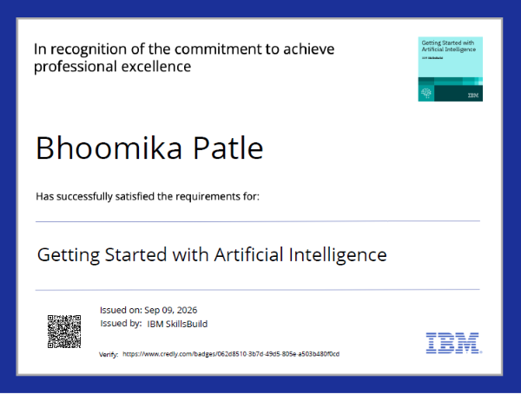
Certificates Earned:

Slide 18
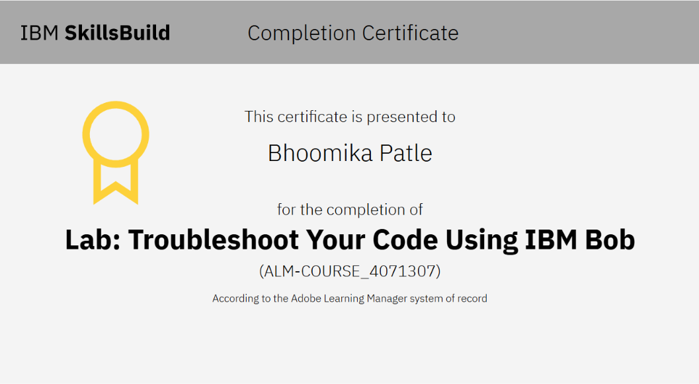
Certificates Earned:​

Slide 19


